Slide 1

Blockhead: Mario-Style Platformer
CSC 471 Final Project
Connor French

Slide 2
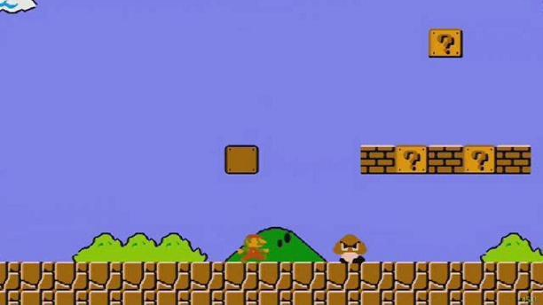
Concept
The idea was to create a platformer similar to 2D Mario games.

Slide 3
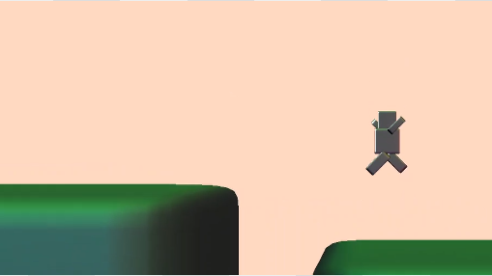
Milestones
Milestone 1: Create main character and platforms; create collision detection for traversal on platforms
Milestone 2: Create basic enemies
End goal: A single level (possibly generated without an end) that contains numerous obstacles and enemies for the character to deal with

Slide 4
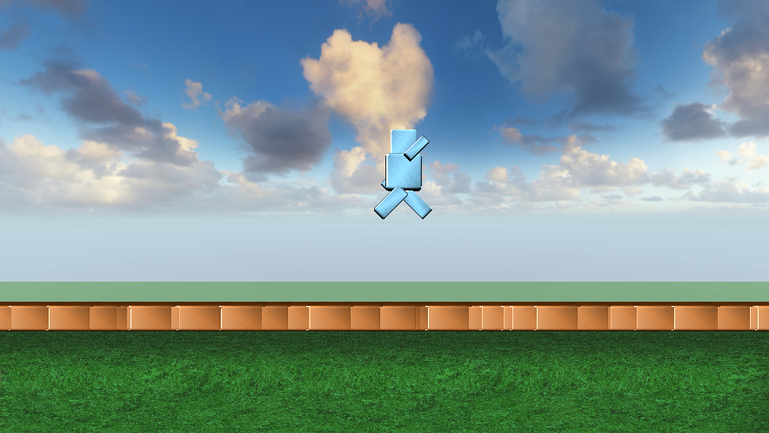
Difficulties
Collision Errors
Rendering Too Many Objects
Resizing the Player

Slide 5
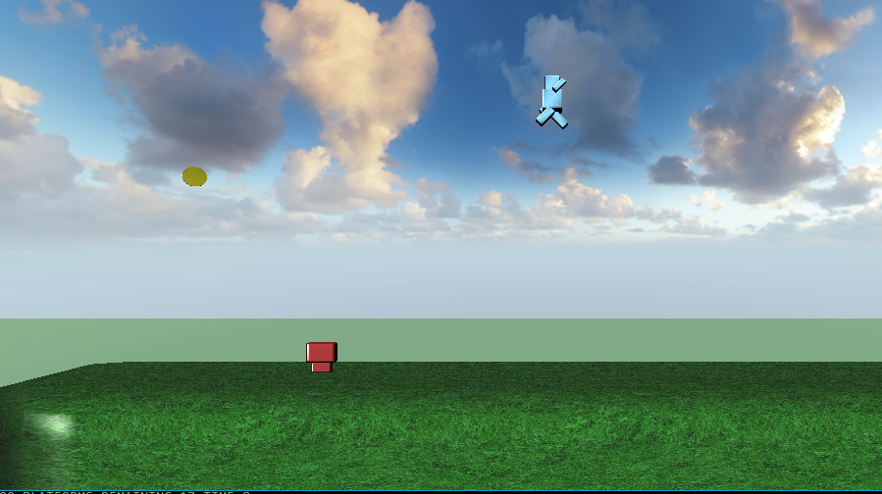
Improvements
Adding On-Screen Text
Adding aerial enemies/platforms
Creating multiple levels

